Slide 1
Software Design and Architecture
Iterator and Composite Patterns

Slide 2
Design principles
High-level principles
‣ Single Responsibility
‣ Open/Closed
‣ Liskov Substitution Principle
‣ Interface Segregation
‣ Dependency Inversion
Low-level principles
‣ Encapsulate what varies
‣ Program to interfaces, not implementations
‣ Favor composition over inheritance
‣ Strive for loose coupling

Slide 3
Iterator
Behavioral Patterns
observer
decorator
strategy
command
template
null object
state
iterator
Creational Patterns
factory method
abstract factory
singleton
Structural Patterns
adapter
facade

Slide 4
Problem
Aggregate objects such as a list
should allow a way to traverse
its elements without exposing
its internal structure
You don’t want to know how this is implemented

Slide 5
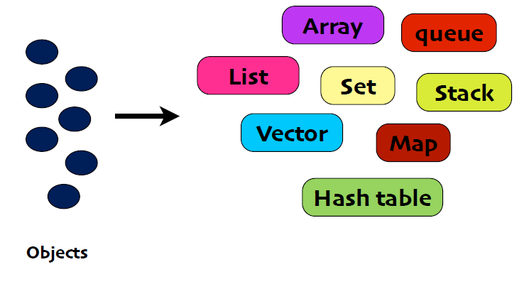
Collection Managers

Slide 6
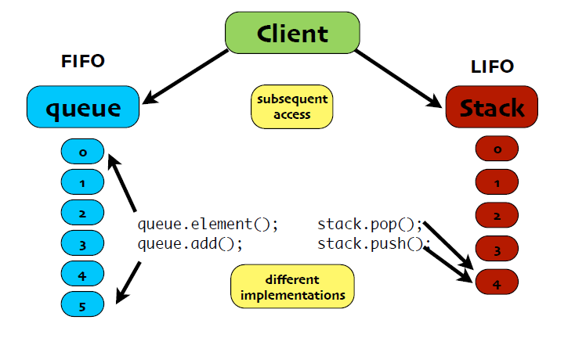
Problem

Slide 7
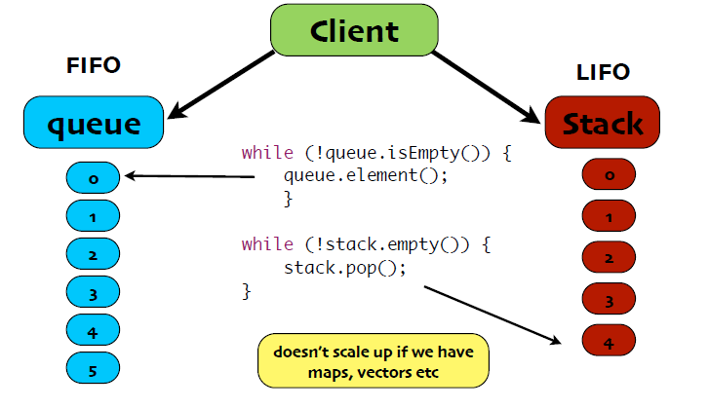
Ugly Way to Access

Slide 8
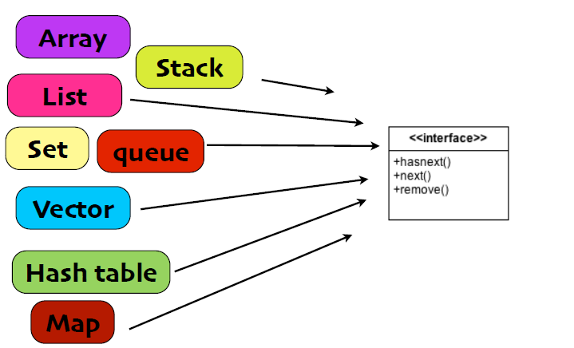
One interface?

Slide 9
Iterator Pattern
The Iterator Pattern provides a way to access the elements of an aggregate object sequentially without exposing its underlying representation.

Slide 10
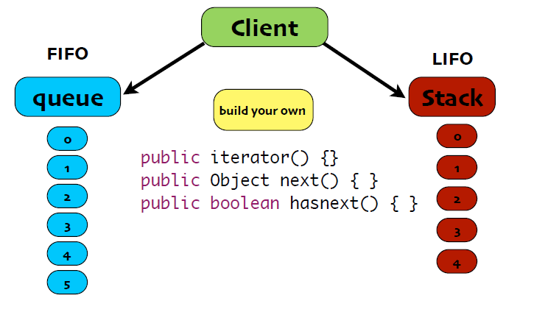
Iterator approach

Slide 11
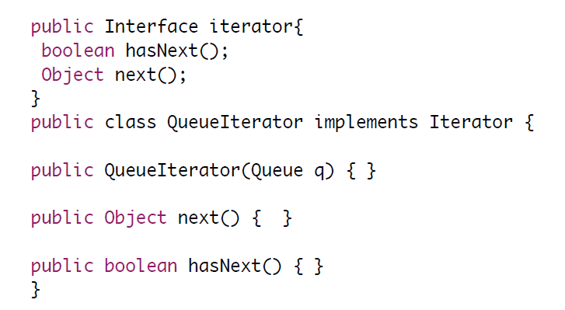
Build Your Own

Slide 12
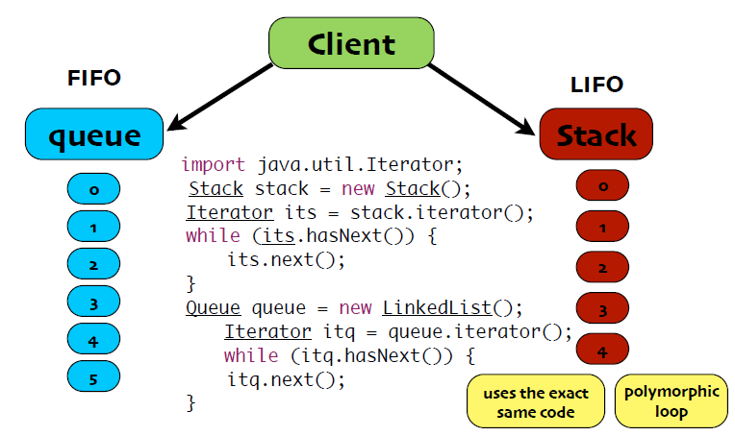
or Use Java

Slide 13
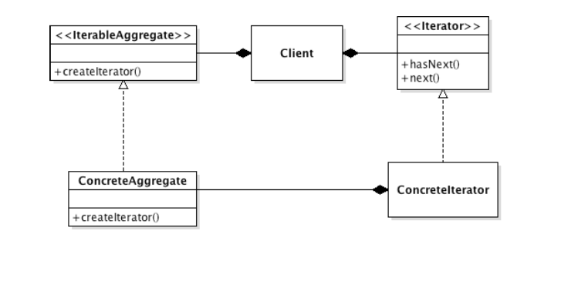
Class Diagram

Slide 14


Slide 15
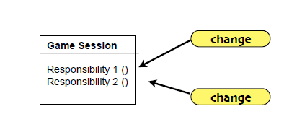
Design Principle
A Class should have only one reason to change

Slide 16
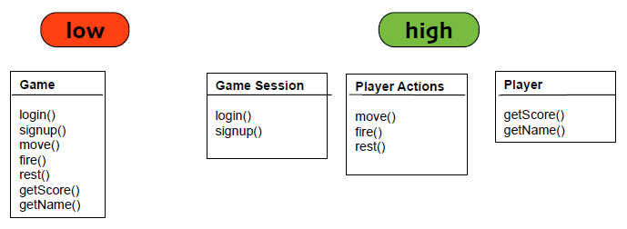
Cohesion
How closely a class supports a single purpose

Slide 17
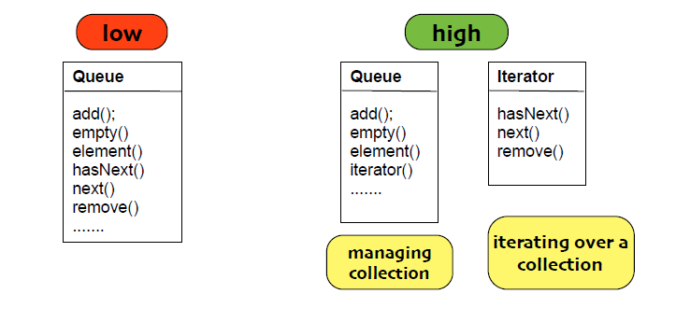
Class for Iterator

Slide 18
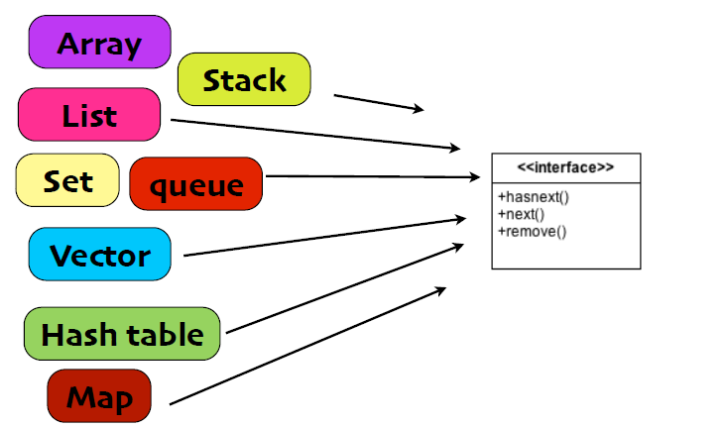
Collections Interface

Slide 19
Composite
Behavioral Patterns
observer
decorator
strategy
command
template
state
iterator
Creational Patterns
factory method
abstract factory
singleton
Structural Patterns
adapter
façade
composite

Slide 20
Problem
When dealing with tree-structured data, programmers often have to discriminate between a leaf-node and a branch. This makes code more complex, and therefore, error prone.

Slide 21
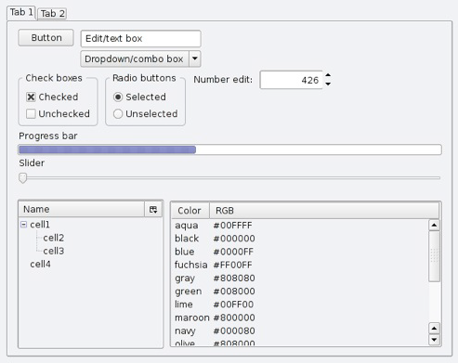
Example GUI’s

Slide 22
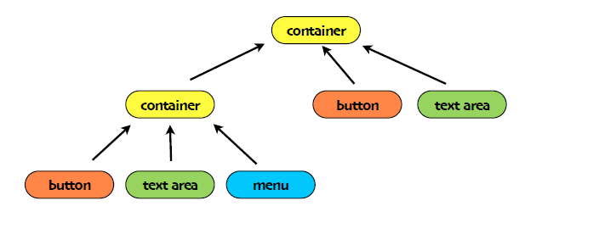
widget

Slide 23
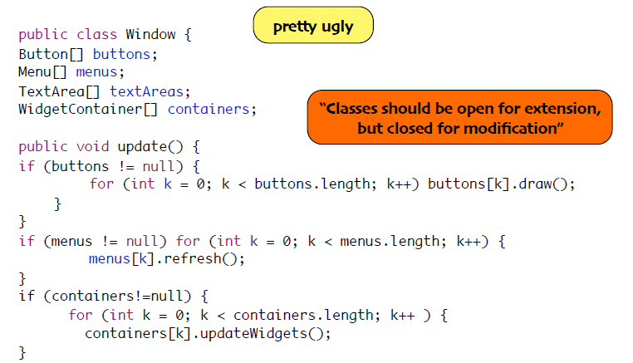
Possible implementation

Slide 24
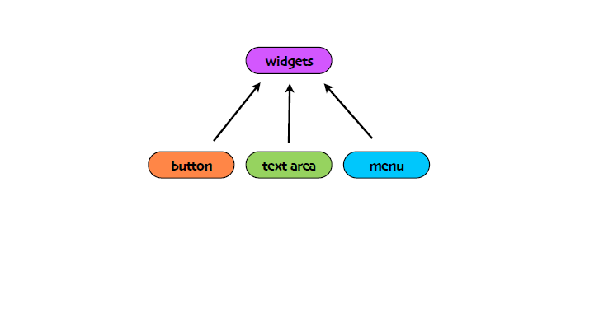
Abstraction

Slide 25
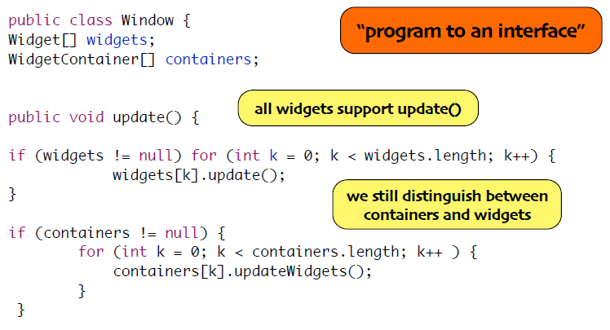
Refactor

Slide 26
Composite Pattern
The Composite Pattern allows you to compose objects into tree structures to represent part-whole hierarchies. Composite lets clients treat individual objects and compositions of objects uniformly

Slide 27
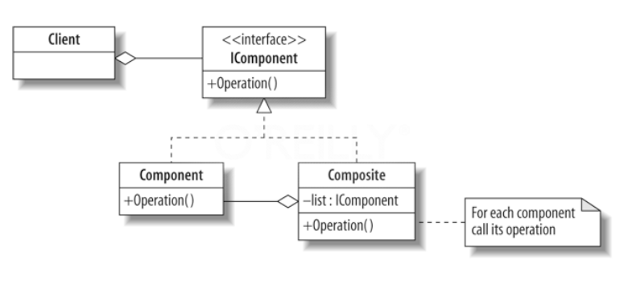
Class Diagram

Slide 28
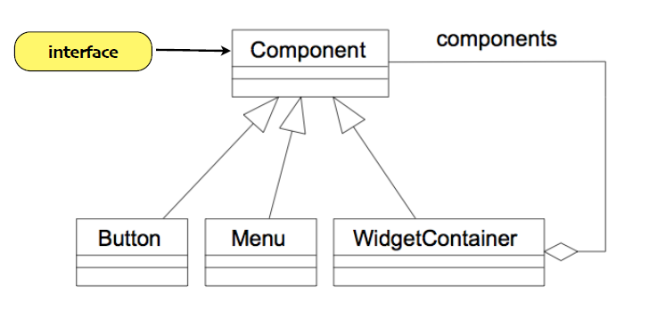
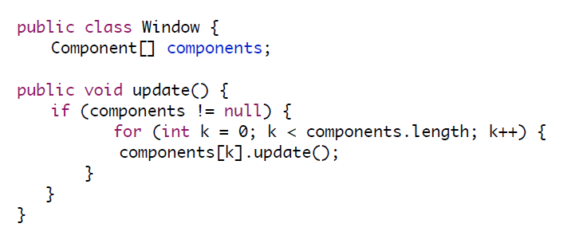
for our GUI

Slide 29
Implementation issues
Where should the child management methods (add(), remove(), getChild()) be declared?

Slide 30
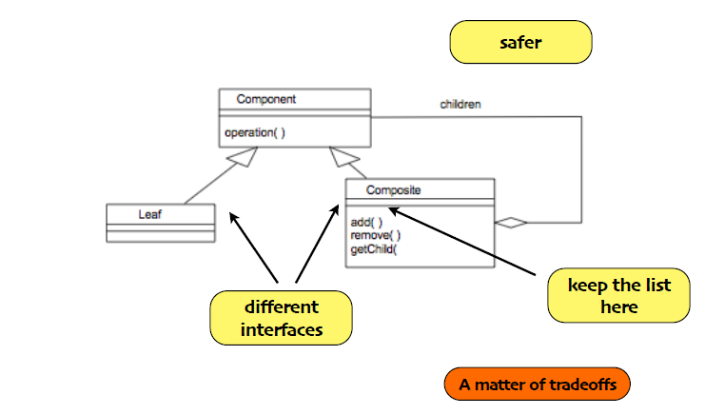
In Composite?

Slide 31
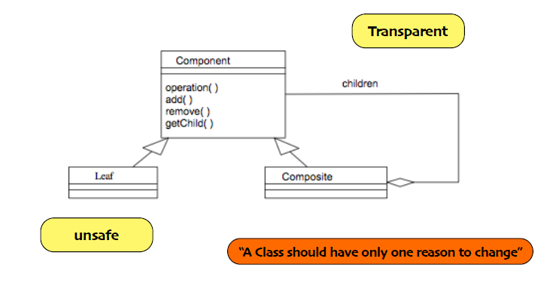
In Component?

Slide 32
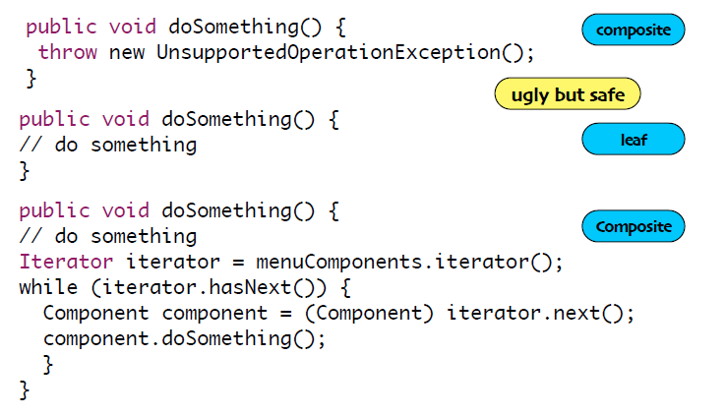
Internal Iterator : see Menu Package

Slide 33
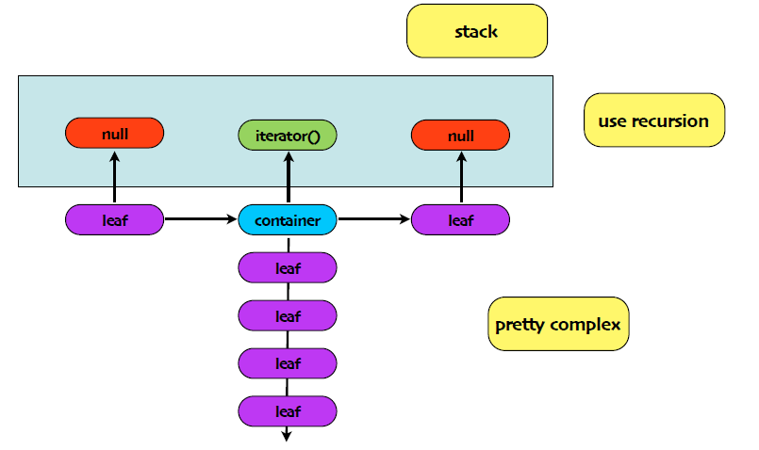
External Iterator: see MenuIterator package

